Slide 1
MERSCOPE Overview
Based on multiplexed error-robust FISH (MERFISH)
100 nm resolution
Up to 500 gene targets
1 cm² imaging area
Data returned as table of molecule coordinates
Results can be explored in Vizgen’s Vizualizer GUI
After segmentation, compatible with most spatial analysis workflows
Notes:
Is custom staining an option?
Sensitivity?~
NBL experiment raw = 10TB
final result = 3.4GB
MERSCOPE has built-in segmentation (watershed)

Slide 2
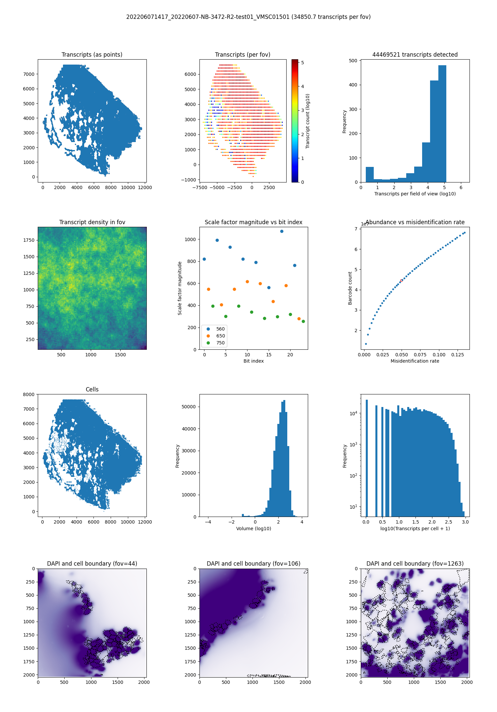
MERSCOPE QC
Notes:
MERSCOPE QC

Slide 3
MERSCOPE QC

Slide 4
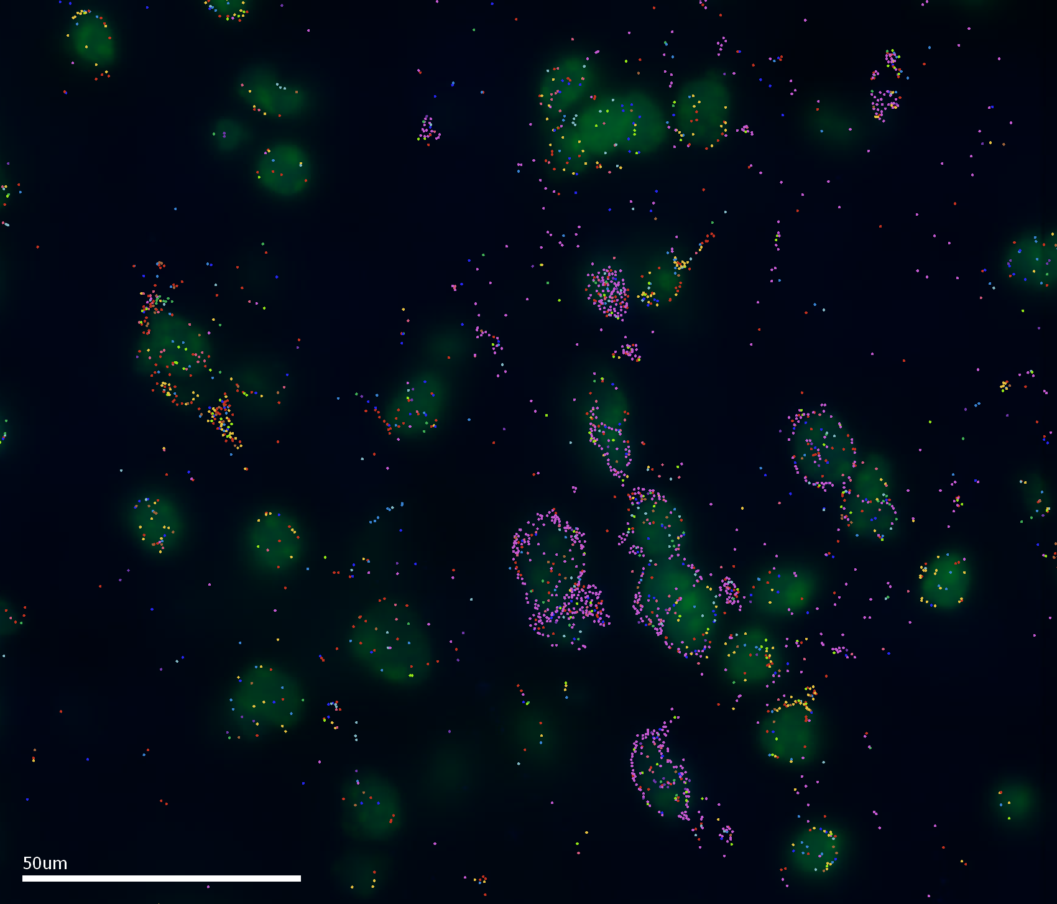
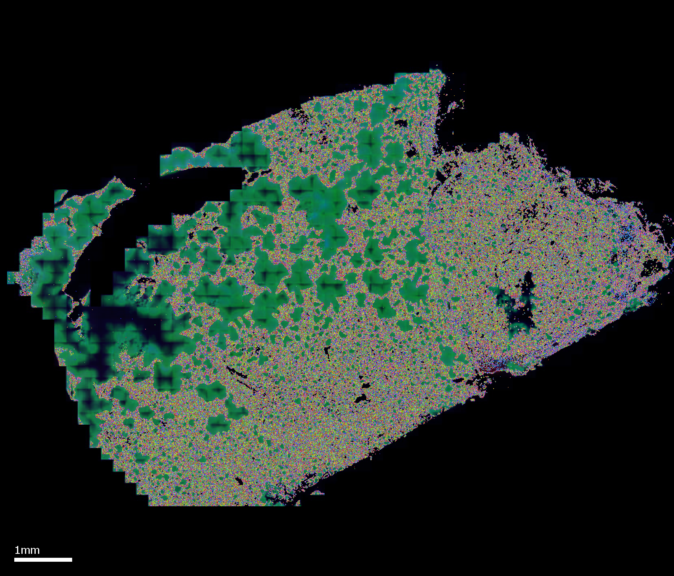
DAPI + Poly-T stain
DEMO
NBL
Notes:
DAPI + PolyT signal are blown out. However, this is something we can now fix

Slide 5
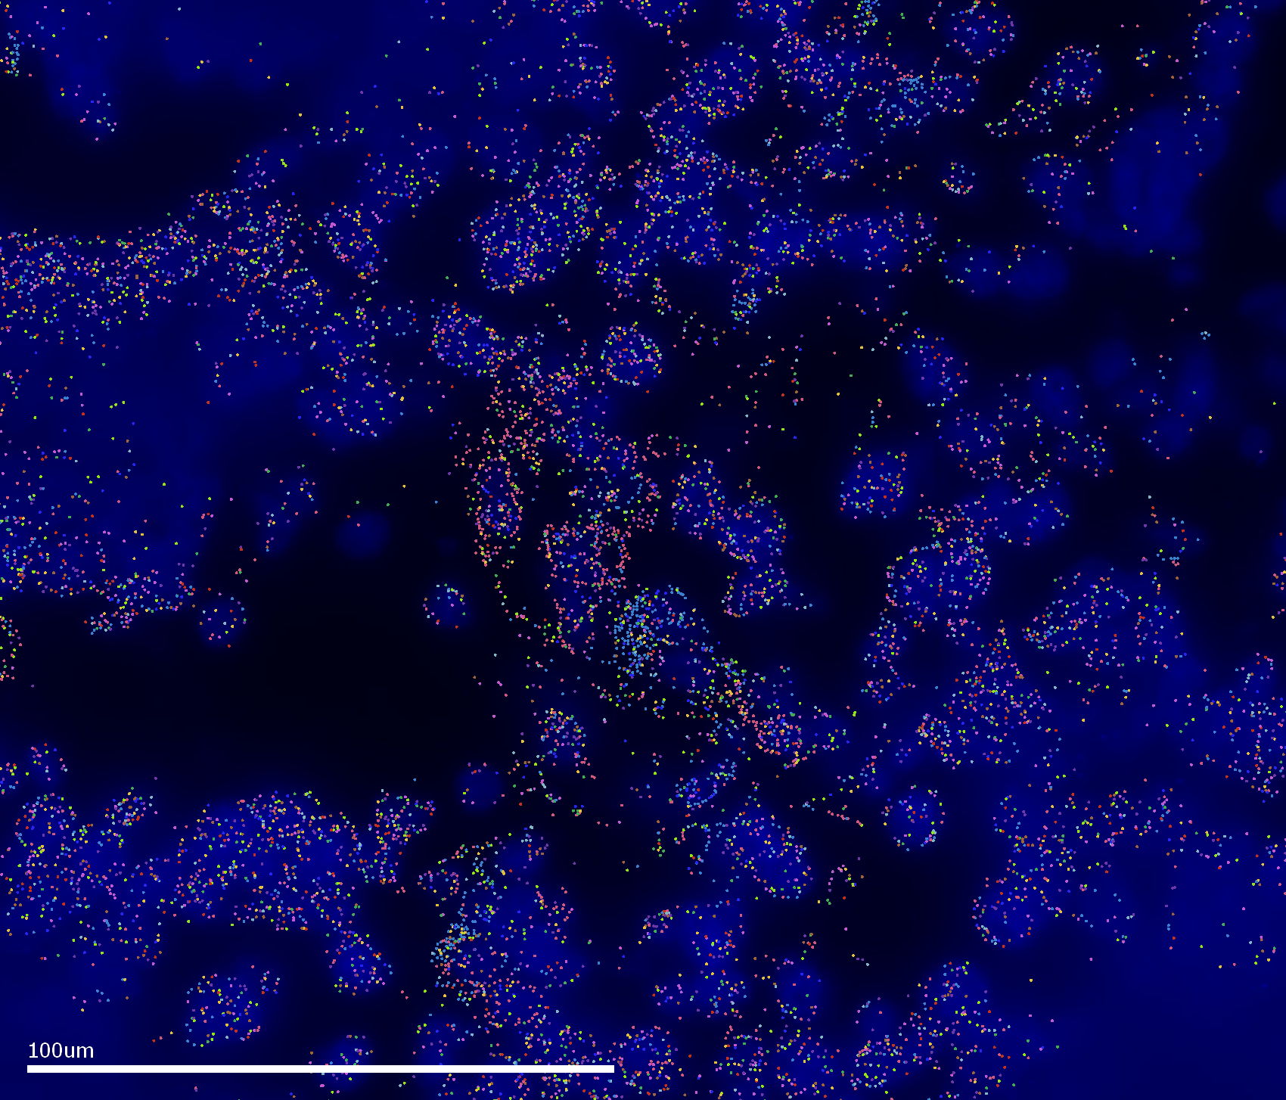
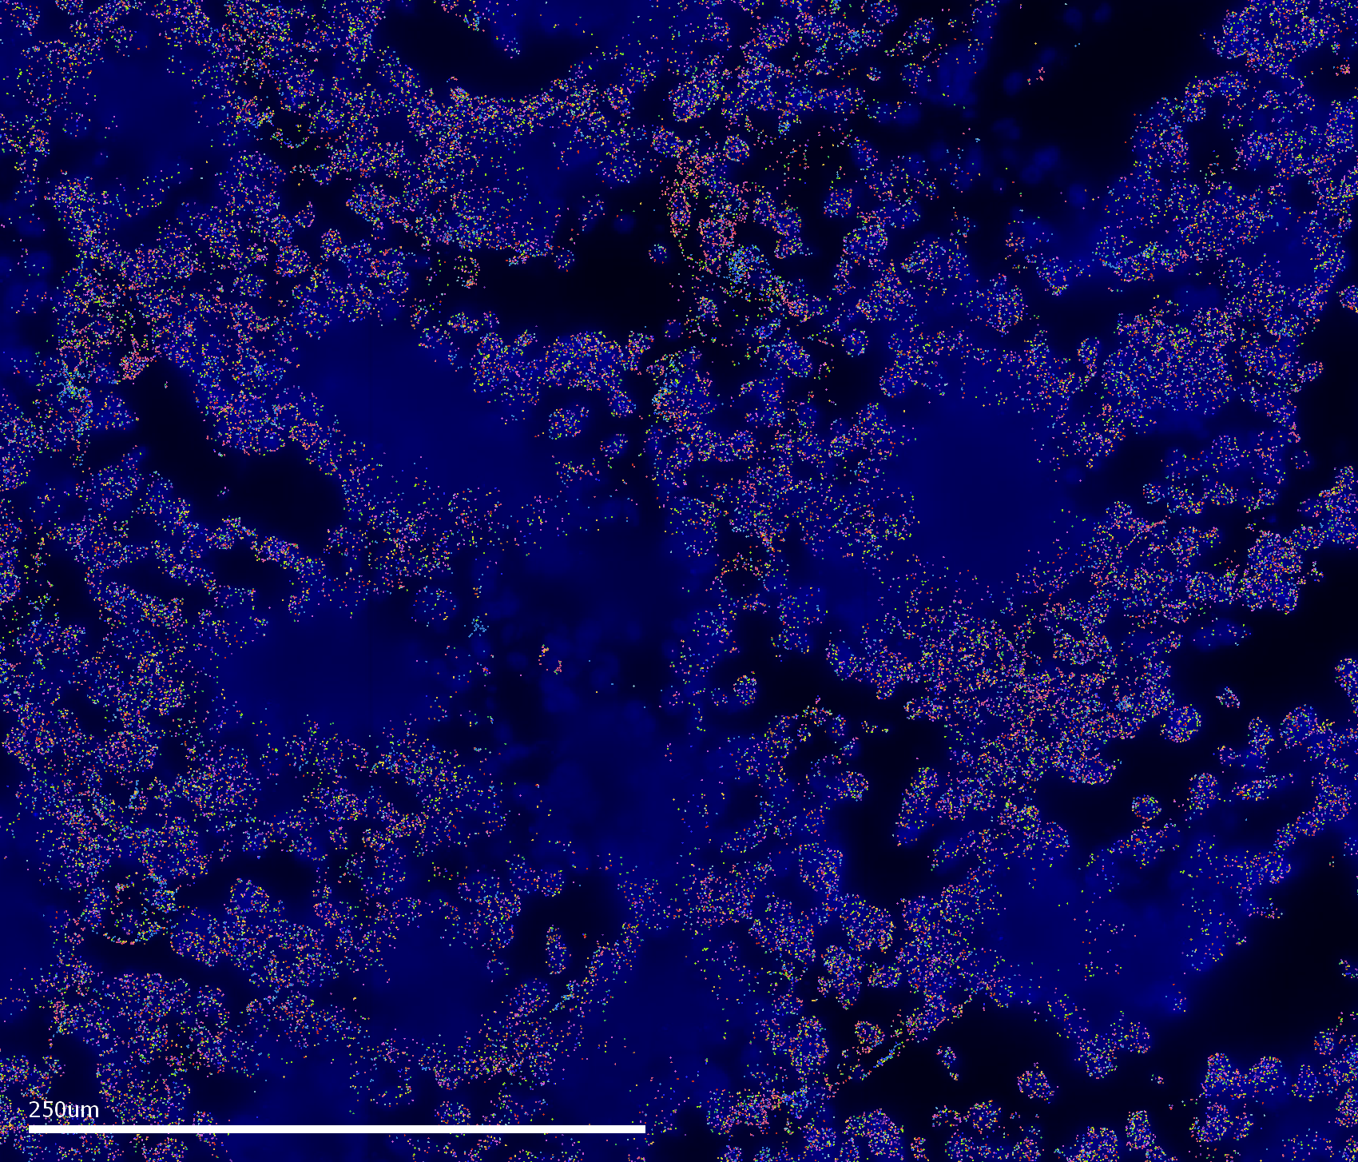
DAPI + Poly-T stain, NBL
Notes:
The polyT stain worked better than DAPI. Somewhat useful for segmentation, but folds in the tissue (or other technical problems) created gaps of low quality resolution/data (right image)

Slide 6
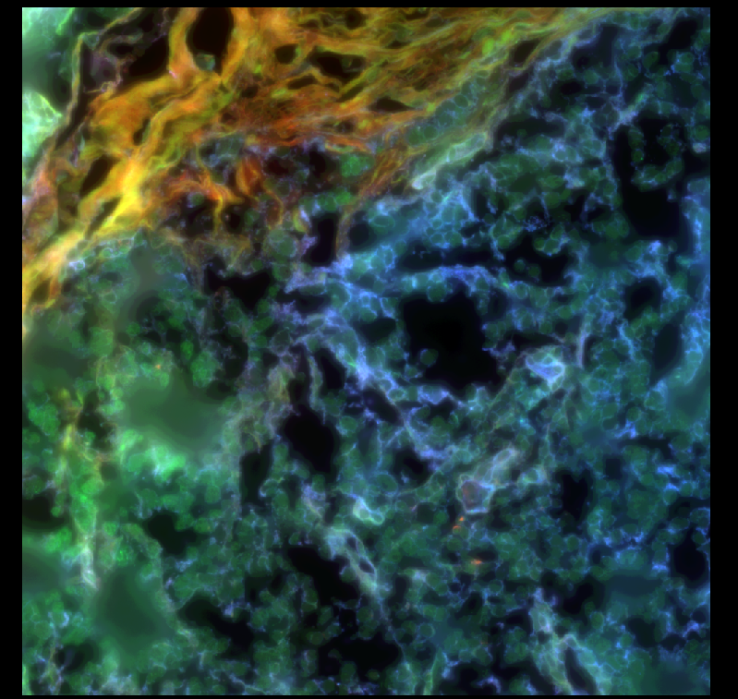
Boundary staining
Notes:
Cocktail of three proprietary Ab’s

Slide 7
Segmentation options
Mesmer
Baysor
“segmentation-free”
On a molecule-to-molecule basis, the composition of the molecular neighborhood is used to determine the likelihood of nearby molecules belonging to the same cell
Other…
Notes:
Does not use pixels or pre-trained models to identify cells, hence “segmentation-free”

Slide 8
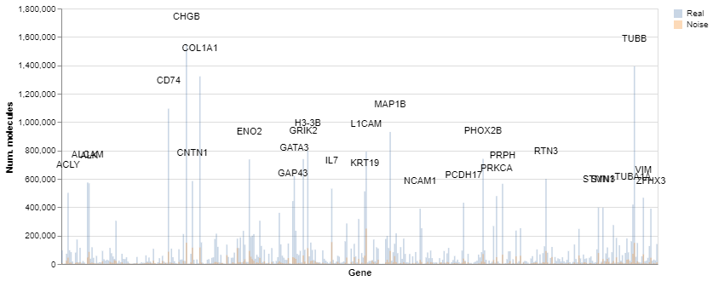
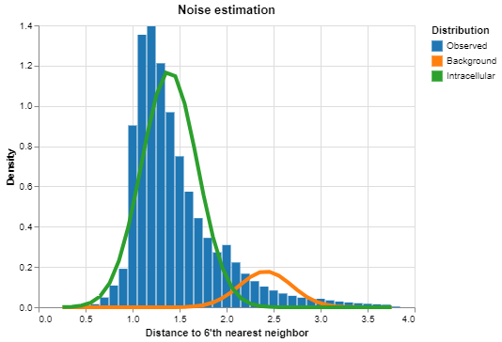
Baysor QC, signal/noise
Notes:
Histogram units are in micrometer

Slide 9
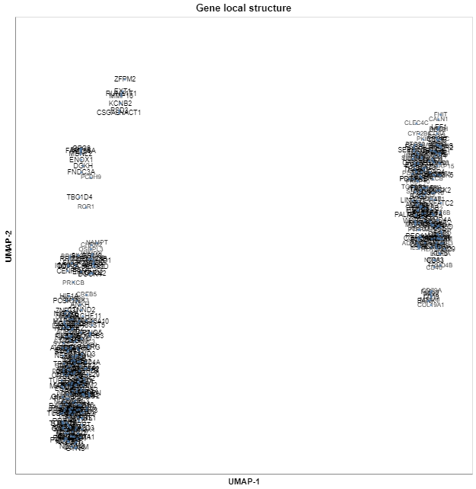
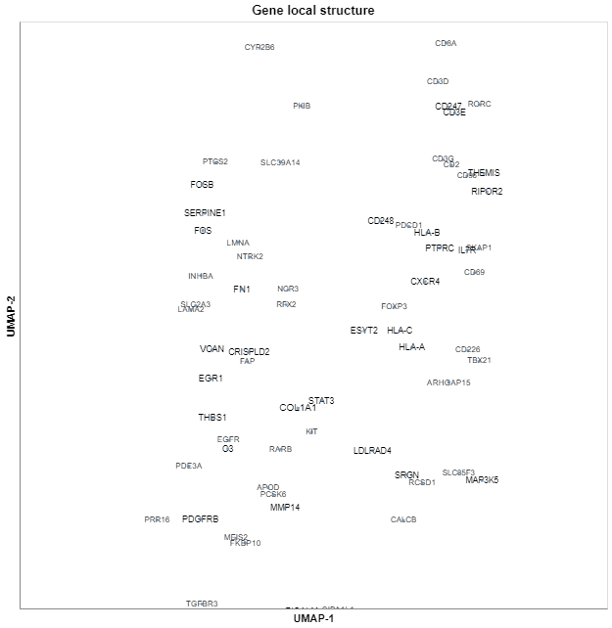
Baysor QC, signal/noise
Full manifold
Zoom

Slide 10
Segmentation summary
 | Demo | NBL
# Probes | 135 | 398
Genes/cell, Q25 | 11 | 29
Genes/cell, Q50 | 21 | 65
Genes/cell, Q75 | 36 | 104
Counts/cell, Q25 | 25 | 46
Counts/cell, Q50 | 79 | 152
Counts/cell, Q75 | 192 | 329
Notes:
Baysor segmentation does require parameter tuning and evaluation. Can be tedious, but Baysor is pretty robust.
Q=quantile

Slide 11
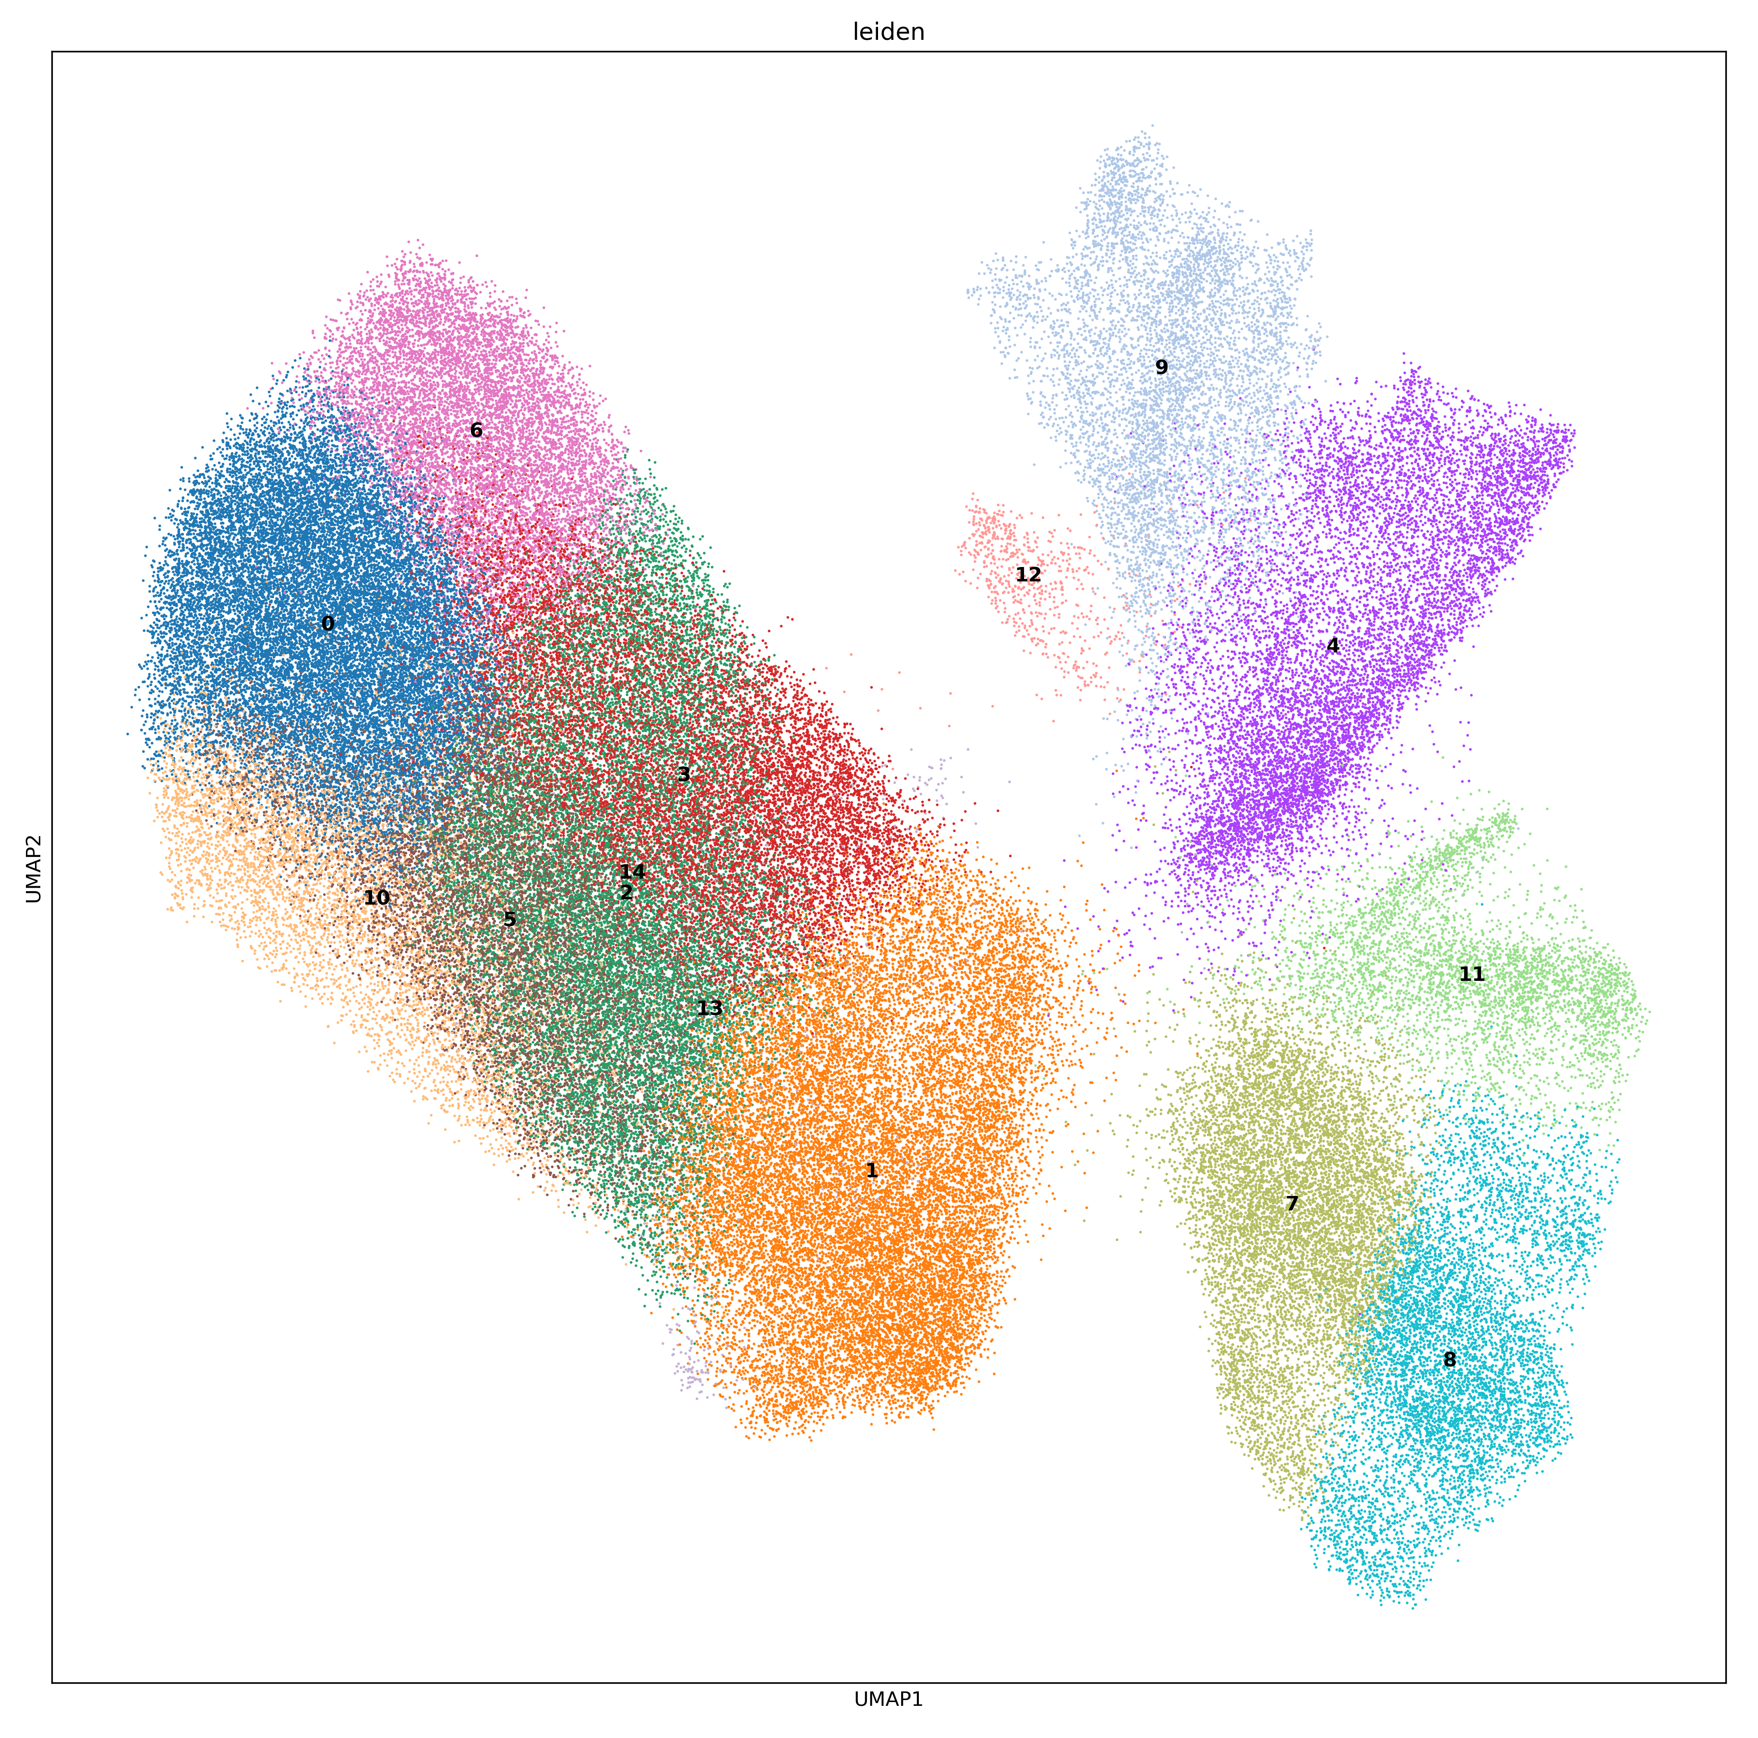
Clustering
Notes:
Data were normalized to 1000 total counts/cell; log1p scaled
Large cluster on left is adrenergic

Slide 12
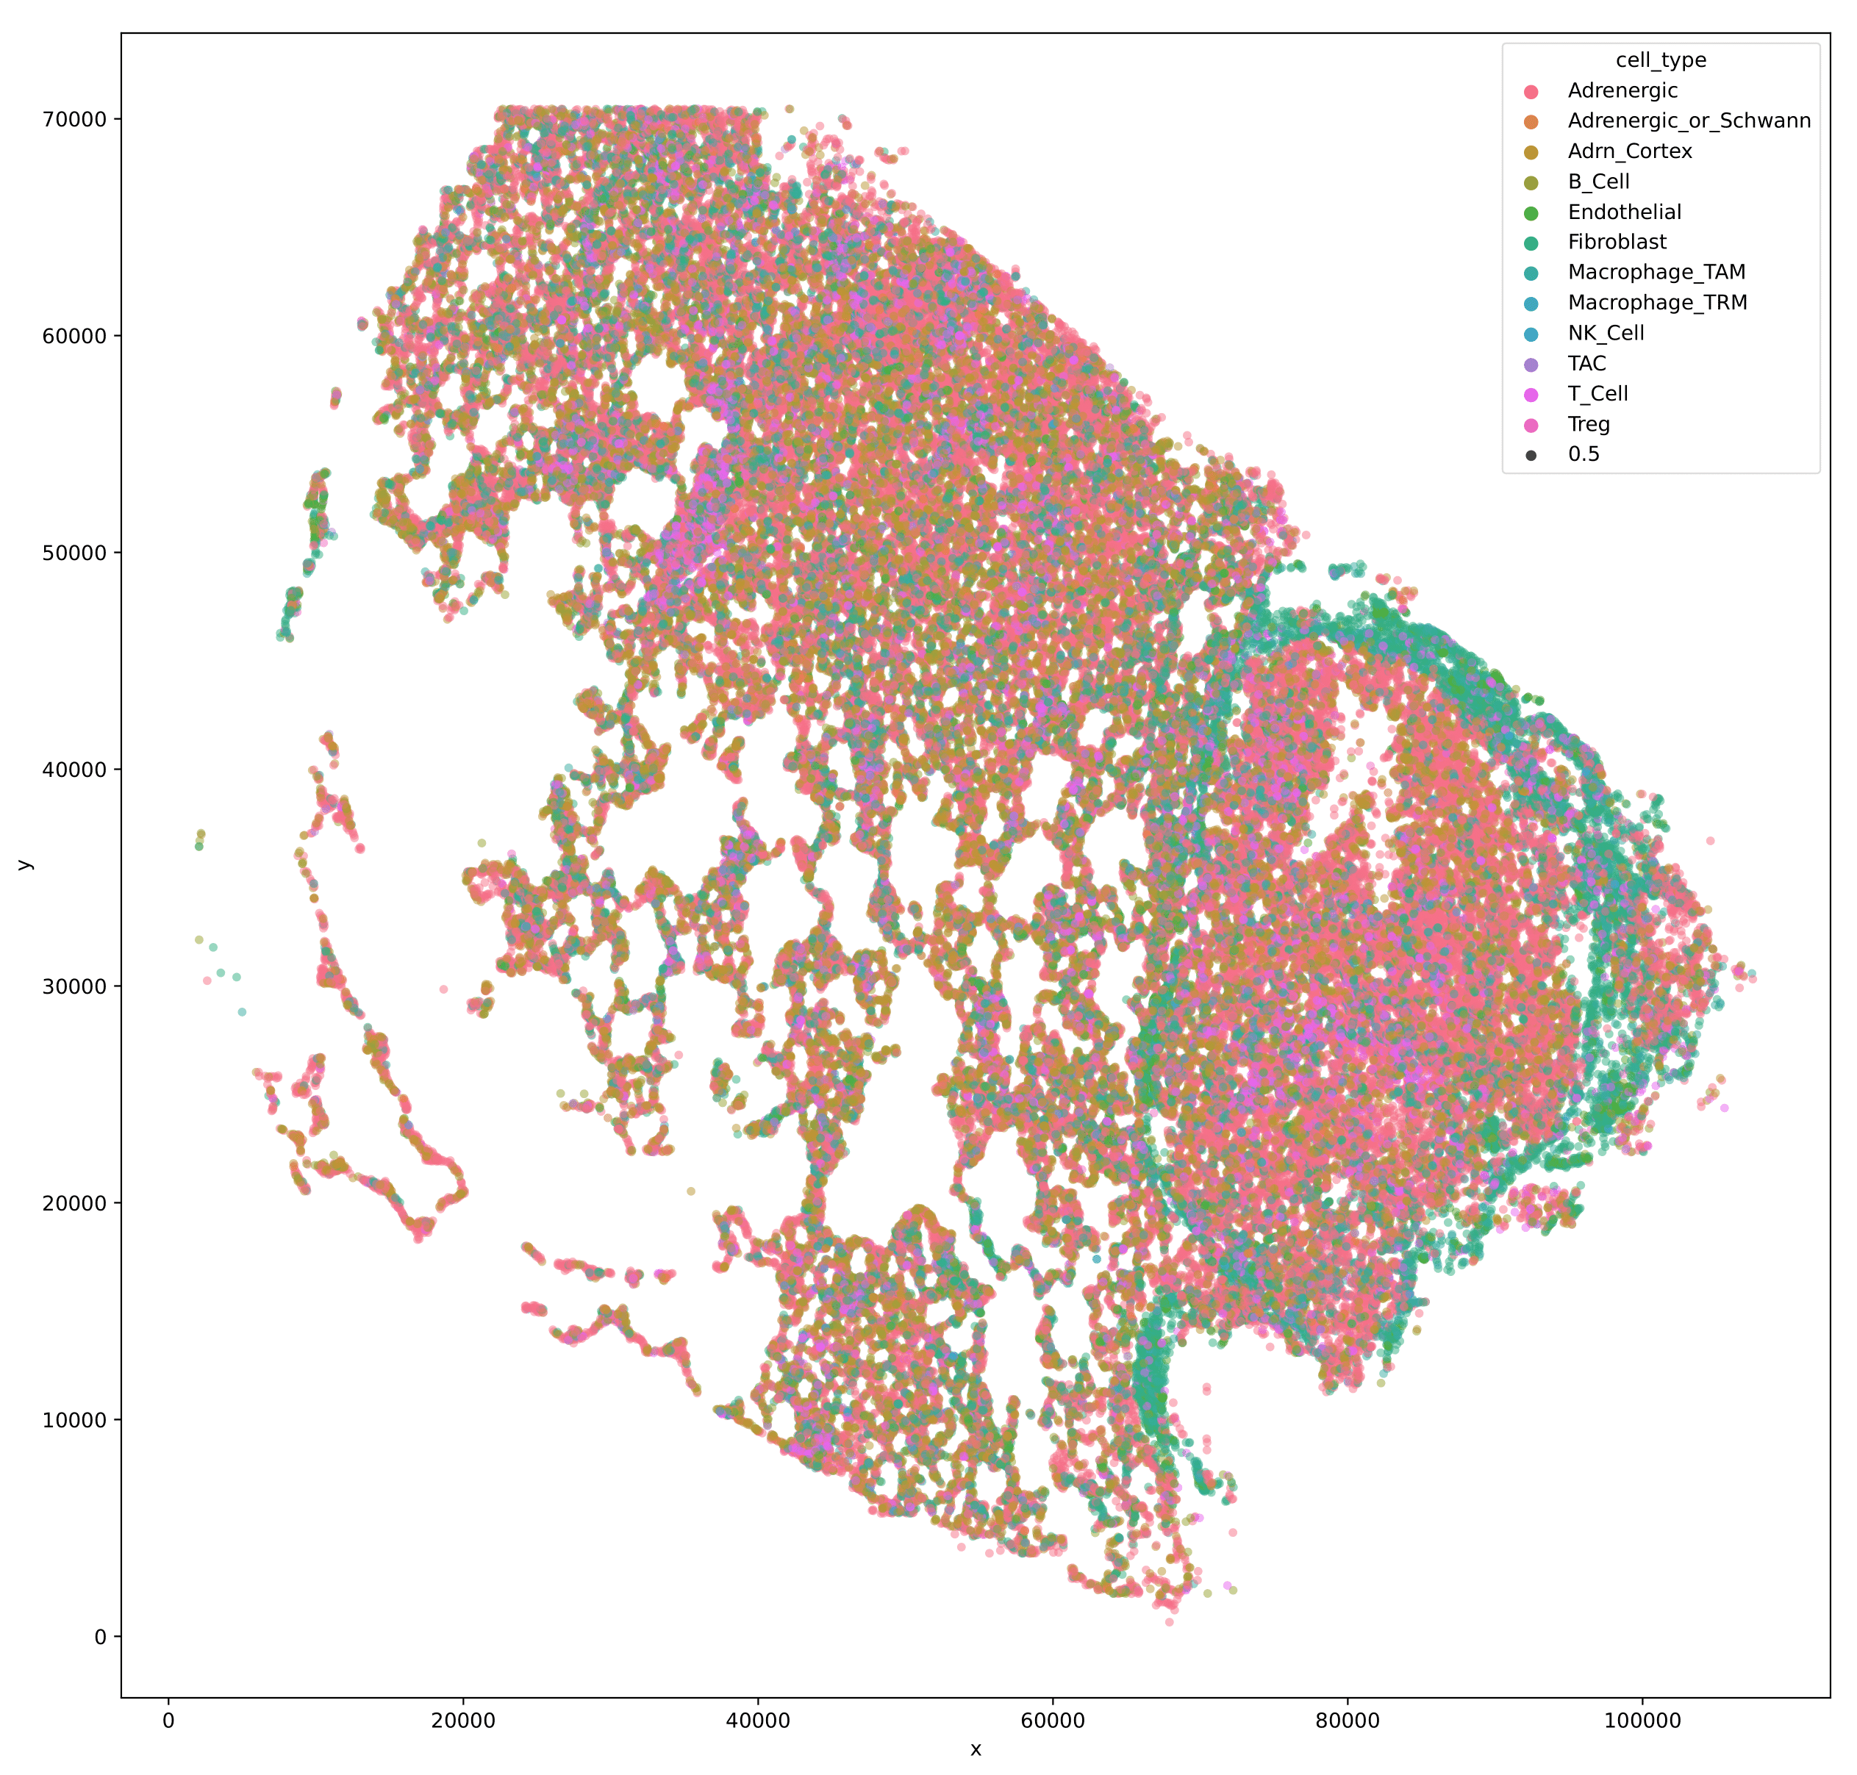
Baysor segmentation results

Slide 13
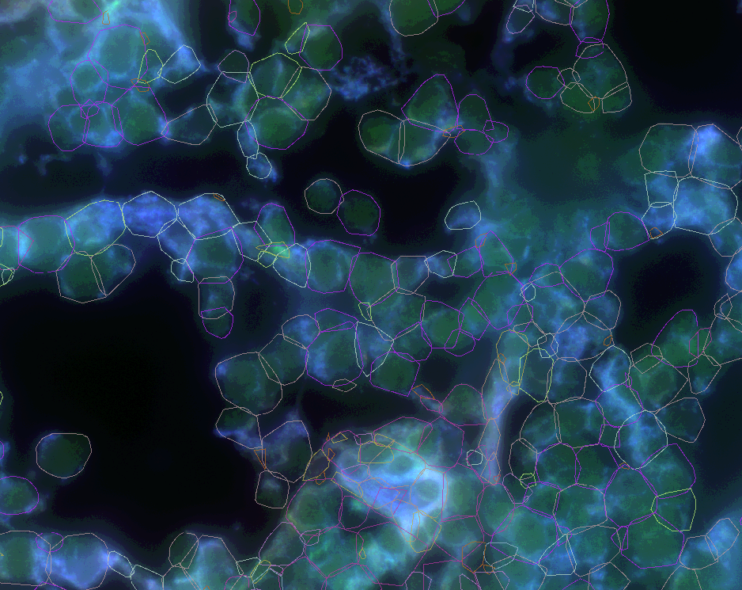
Baysor segmentation results
Notes:
Convex hull of cell labels, overlaid on boundary stain

Slide 14
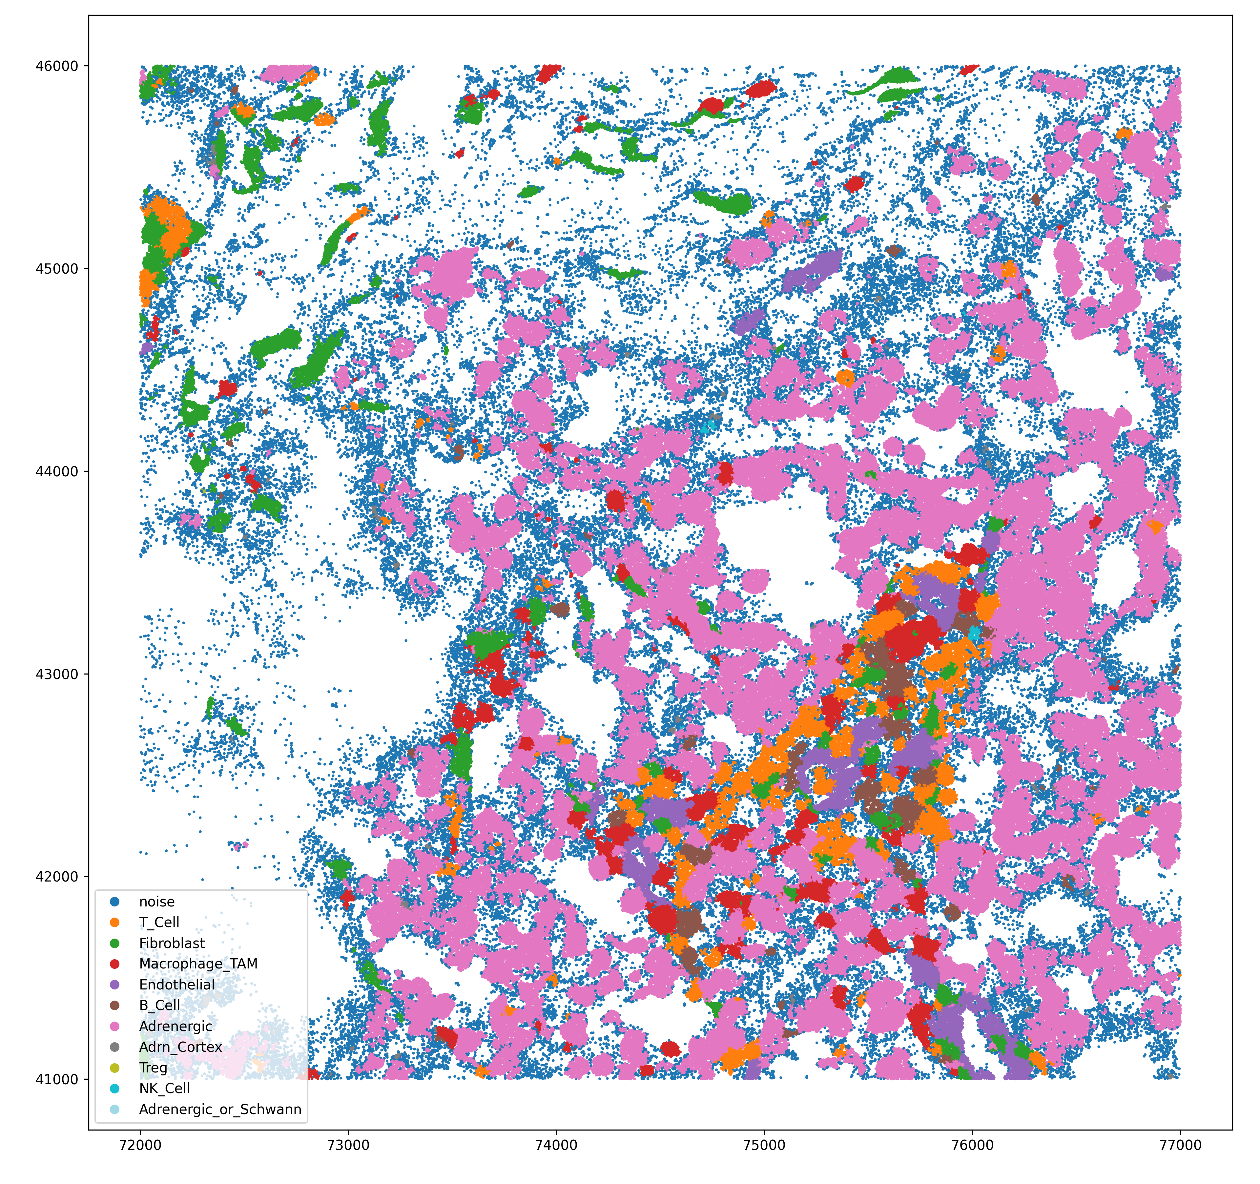
Baysor segmentation results
Notes:
Noise is determined by sparsity.
At this point, data is portable to pretty much any other analysis workflow

Slide 15
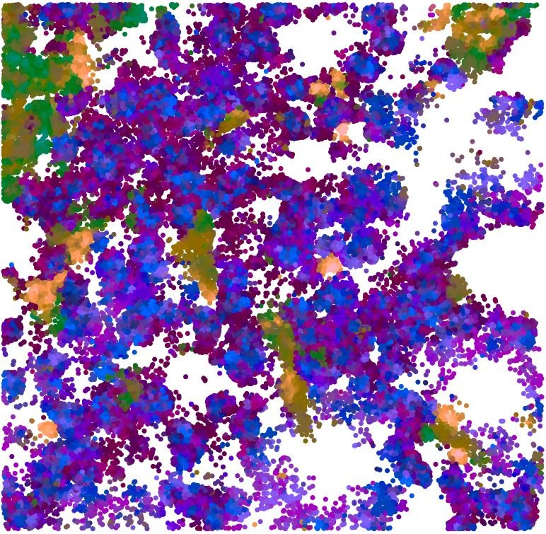
Baysor segmentation results
Notes:
Molecules colored by neighborhood composition vector (NCV). Can see more subcellular patterns of gene coexpression

Slide 16
Next steps…
Define cellular neighborhoods
Cluster TAMs based on cell interaction; differential expression
Investigate gene localization at TAM-[cell] interface

